Slide 1
Advanced Encryption Standard

Slide 2
01
What’s AES ?

Slide 3
Definition
Advanced Encryption Standard, or AES, is a Rijndael block cipher based encryption standard for digital data.

Slide 4
More on details.
AES was developed by two Belgian cryptographers, Joan Daemen and Vincent Rijmen.
It was meant to be a successor for the then obsolete Data Encryption Standard (DES), since DES was starting to become more and more vulnerable to brute-force attacks.
AES is symmetric key and symmetric block cipher, meaning the same key is used for both encrypting and decrypting the data.
Become the cryptographic gold standard worldwide for securely encrypting and preventing unauthorized access to electronic data, still widely used as of today.

Slide 5
THE HISTORY
01
02
03
1997
2001
2002
NIST wished to replace the old DES through community.
Rijndael was chosen by the NIST as the new AES.
Officially included in the ISO/IEC 18033-3 standard.

Slide 6
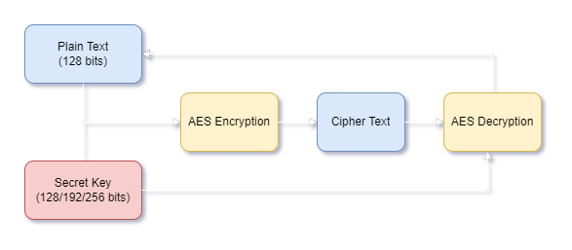
How it works.
The AES creates ciphertext, which is an unreadable, indecipherable conversion of plaintext data, which can only be read after the secret AES key is used to decrypt it.

Slide 7
More on details.
The key size used for an AES cipher specifies the number of transformation rounds that convert the input. The number of rounds are as follows:
10 rounds for 128-bit keys.
12 rounds for 192-bit keys.
14 rounds for 256-bit keys.
For simplicity, we will be using 10 rounds, or 128-bit key, for the example.

Slide 8
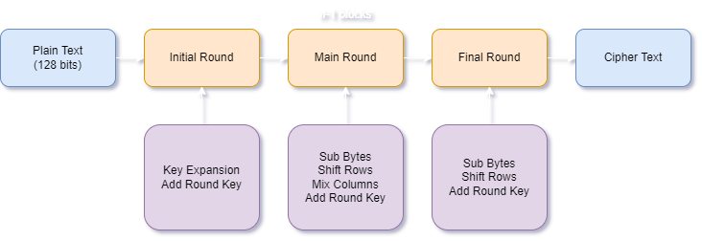
How it works.

Slide 9

Key Expansion
AES uses a separate key schedule to expand a short key into a number of separate round keys.
With each variants having different number of rounds, the key schedule needs to produce the needed round keys for each round.

Slide 10
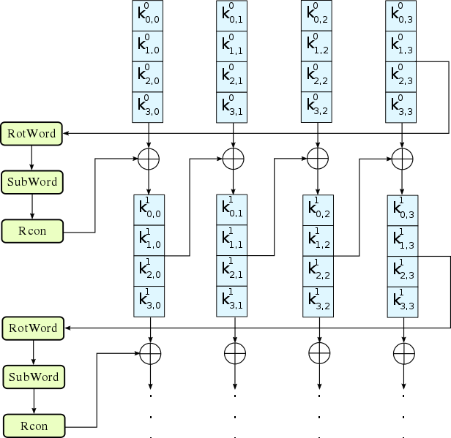
Key Expansion
We can define the Key Schedule as a simple 3-stage process:
Perform Rot Word on the last column of key.
Perform Rot Word on the column.
XOR the column with RCON and then XOR with the i-th column of key.
Repeat 3 while iterating i, until i is equals to 3 (all 4 column of keys required).

Slide 11
Rot Word
Rot Word is basically a left circular shift by 1 position.
01
02
03
04
02
03
04
01

Slide 12
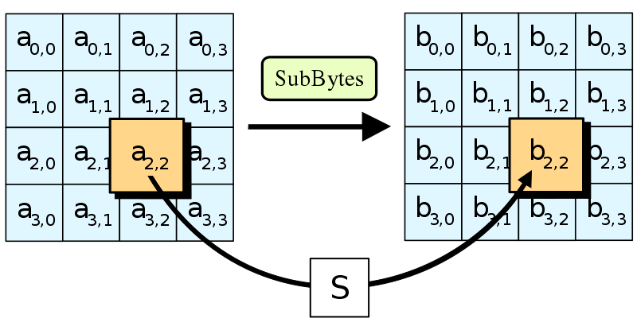
Sub Bytes
Sub Bytes means replacing each byte a(i, j) with the corresponding value in S-Box.

Slide 13
S-Box
The Rijndael S-box used in AES maps an 8-bit input, c, to an 8-bit output, s = S(c).
Rijndael S-box is known to have good non-linearity properties.
 | 00 | 01 | 02 | 03 | 04 | 05 | 06 | 07 | 08 | 09 | 0a | 0b | 0c | 0d | 0e | 0f
00 | 63 | 7c | 77 | 7b | f2 | 6b | 6f | c5 | 30 | 01 | 67 | 2b | fe | d7 | ab | 76
10 | ca | 82 | c9 | 7d | fa | 59 | 47 | f0 | ad | d4 | a2 | af | 9c | a4 | 72 | c0
20 | b7 | fd | 93 | 26 | 36 | 3f | f7 | cc | 34 | a5 | e5 | f1 | 71 | d8 | 31 | 15
30 | 04 | c7 | 23 | c3 | 18 | 96 | 05 | 9a | 07 | 12 | 80 | e2 | eb | 27 | b2 | 75
40 | 09 | 83 | 2c | 1a | 1b | 6e | 5a | a0 | 52 | 3b | d6 | b3 | 29 | e3 | 2f | 84
50 | 53 | d1 | 00 | ed | 20 | fc | b1 | 5b | 6a | cb | be | 39 | 4a | 4c | 58 | cf
60 | d0 | ef | aa | fb | 43 | 4d | 33 | 85 | 45 | f9 | 02 | 7f | 50 | 3c | 9f | a8
70 | 51 | a3 | 40 | 8f | 92 | 9d | 38 | f5 | bc | b6 | da | 21 | 10 | ff | f3 | d2
80 | cd | 0c | 13 | ec | 5f | 97 | 44 | 17 | c4 | a7 | 7e | 3d | 64 | 5d | 19 | 73
90 | 60 | 81 | 4f | dc | 22 | 2a | 90 | 88 | 46 | ee | b8 | 14 | de | 5e | 0b | db
a0 | e0 | 32 | 3a | 0a | 49 | 06 | 24 | 5c | c2 | d3 | ac | 62 | 91 | 95 | e4 | 79
b0 | e7 | c8 | 37 | 6d | 8d | d5 | 4e | a9 | 6c | 56 | f4 | ea | 65 | 7a | ae | 08
c0 | ba | 78 | 25 | 2e | 1c | a6 | b4 | c6 | e8 | dd | 74 | 1f | 4b | bd | 8b | 8a
d0 | 70 | 3e | b5 | 66 | 48 | 03 | f6 | 0e | 61 | 35 | 57 | b9 | 86 | c1 | 1d | 9e
e0 | e1 | f8 | 98 | 11 | 69 | d9 | 8e | 94 | 9b | 1e | 87 | e9 | ce | 55 | 28 | df
f0 | 8c | a1 | 89 | 0d | bf | e6 | 42 | 68 | 41 | 99 | 2d | 0f | b0 | 54 | bb | 16
09
0A
0B
1C
01
67
2B
9C

Slide 14
RCON Table
i | 1 | 2 | 3 | 4 | 5 | 6 | 7 | 8 | 9 | 10
rc_{i} | 01 | 02 | 04 | 08 | 10 | 20 | 40 | 80 | 1B | 36
 | 00 | 00 | 00 | 00 | 00 | 00 | 00 | 00 | 00 | 00
 | 00 | 00 | 00 | 00 | 00 | 00 | 00 | 00 | 00 | 00
 | 00 | 00 | 00 | 00 | 00 | 00 | 00 | 00 | 00 | 00

Slide 15
01 | 05 | 09 | 0D
02 | 06 | 0A | 0E
03 | 07 | 0B | 0F
04 | 08 | 0C | 10
0D
0E
0F
10
0E
0F
10
0D
D7
AB
76
CA
Last column
Rot
Word
Sub
Bytes
01
02
03
04
D7
AB
76
CA
D6
A9
75
CE
01
00
00
00
D7 | ? | ? | ?
A9 | ? | ? | ?
75 | ? | ? | ?
CE | ? | ? | ?
XOR
XOR
RCON(1)

Slide 16
Key Expansion
We can define the Key Schedule as a simple 3-stage process:
Perform Rot Word on the last column of key.
Perform Rot Word on the column.
XOR the column with RCON and then XOR with the i-th column of key.
Repeat 3 while iterating i, until i is equals to 3 (all 4 column of keys required).

Slide 17
How it works.

Slide 18
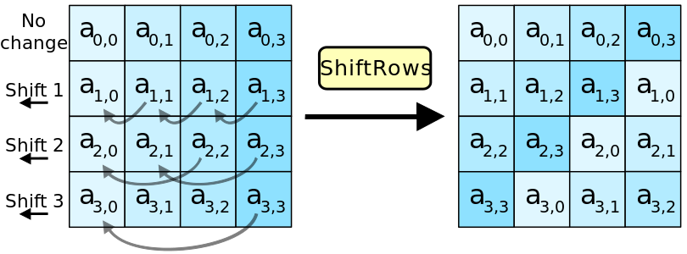
Shift Rows

Slide 19
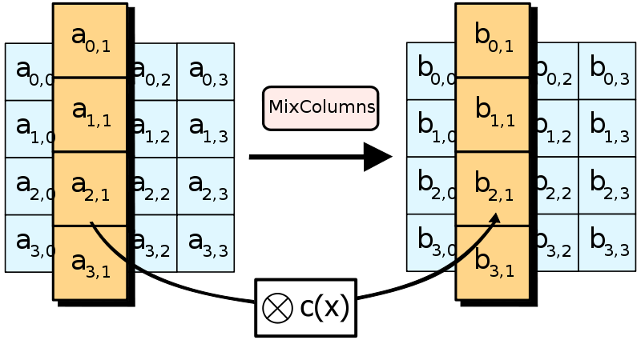
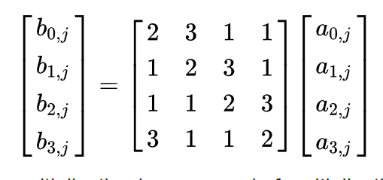
Column Mix

Slide 20
Column Mix
R1
R2
R3
R4
2 | 3 | 1 | 1
1 | 2 | 3 | 1
1 | 1 | 2 | 3
3 | 1 | 1 | 2
(2 dot R1) XOR (3 dot R2) XOR (1 dot R3) XOR (1 dot R4)
(1 dot R1) XOR (2 dot R2) XOR (3 dot R3) XOR (1 dot R4)
(1 dot R1) XOR (1 dot R2) XOR (2 dot R3) XOR (3 dot R4)
(3 dot R1) XOR (1 dot R2) XOR (1 dot R3) XOR (2 dot R4)
X

Slide 21
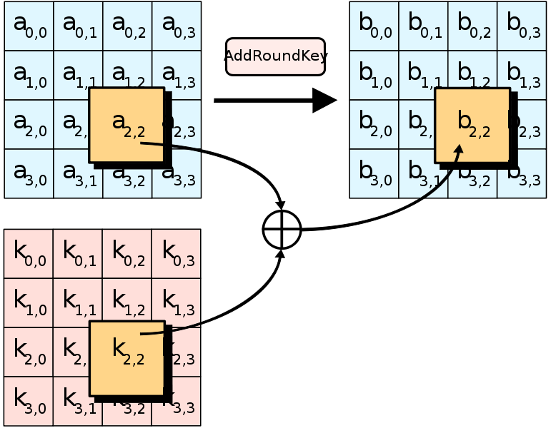
Add Round Key

Slide 22
Modes of Operation
Normally, AES would only encrypt a 128 bit plain-text block of data, so for bigger data, we needs to have a rule to apply AES. Modes of operation is made to regulate this problem, defining how each block would be encrypted in a large file.
There are many mode of operation, but the two most commonly used are:
Electronic codebook (ECB)
Cipher block chaining (CBC)

Slide 23
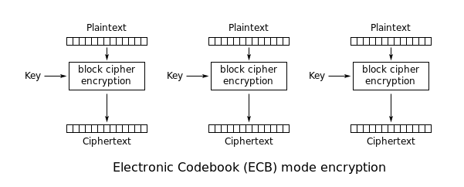
ECB Mode

Slide 24
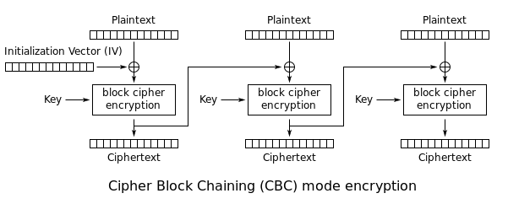
CBC Mode

Slide 25
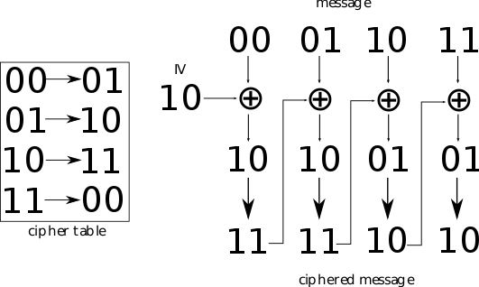
How IV works

Slide 26



Why ECB isn’t
Original
ECB
CBC

